Slide 1
Linear Algebra
Lecture 5

Slide 2
Systems of
Linear Equations

Slide 3
Vector
Equations

Slide 4
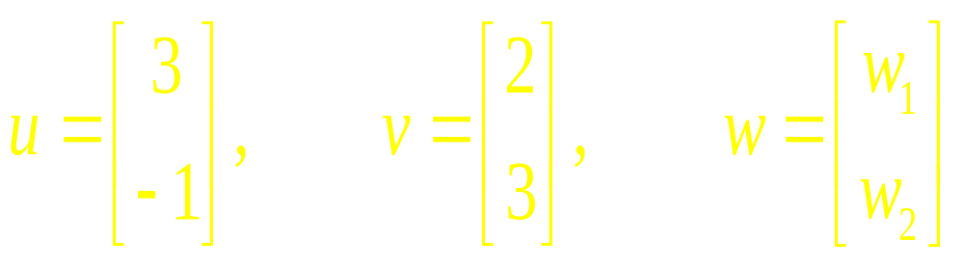
Vectors in R²
Example

Slide 5
Algebra of
Vectors
Equality
Addition
Subtraction
Multiple

Slide 6
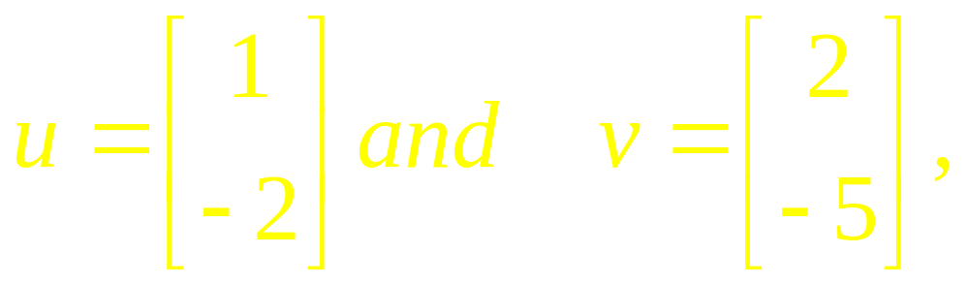
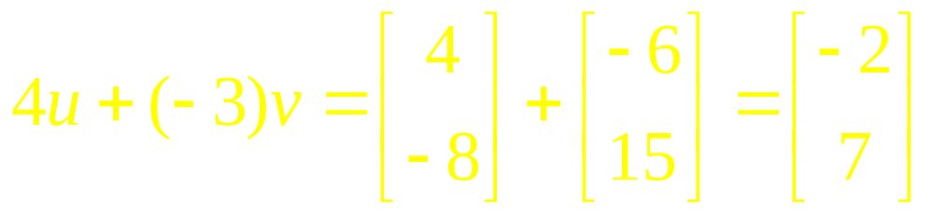
Example

Slide 7
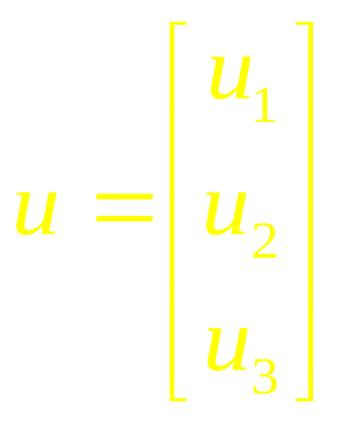
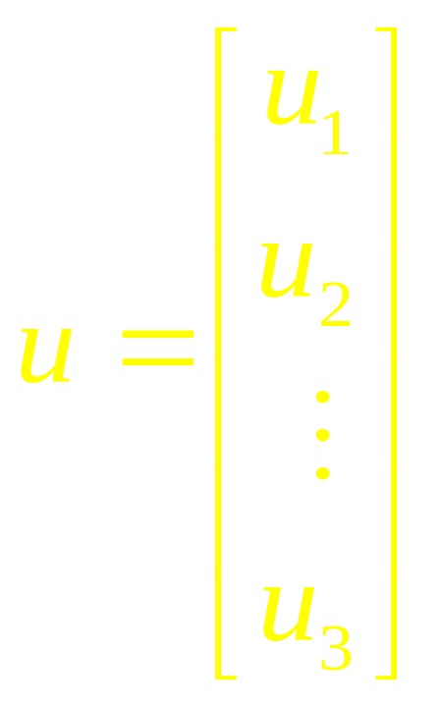
Vectors in R³
Vectors in R^{n}

Slide 8
Algebraic Properties
For all u, v, w in R^{n} and all scalars c and d:
u + v = v + u
(u + v) + w = u + (v + w)

Slide 9
Algebraic Properties
  u + 0 = 0 + u = u
  u + (–u) =( –u) + u = 0
where –u denotes (–1)u

Slide 10
Algebraic Properties
  c(u + v) = cu + cv
  (c + d)u = cu + du
  c(du) = (cd)(u)
  1u = u

Slide 11
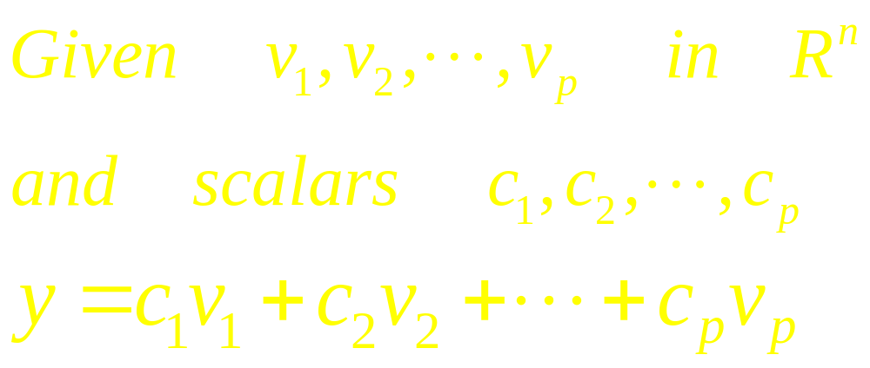
Linear Combination

Slide 12
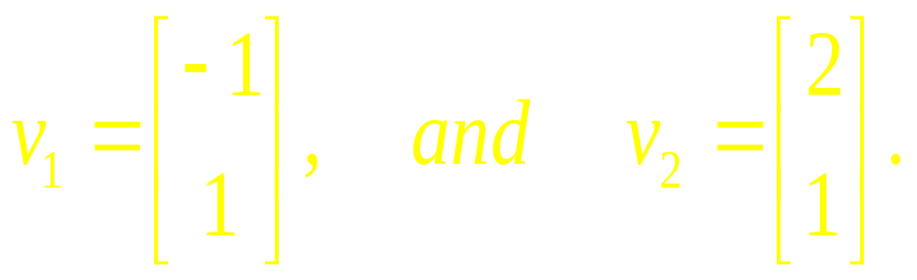
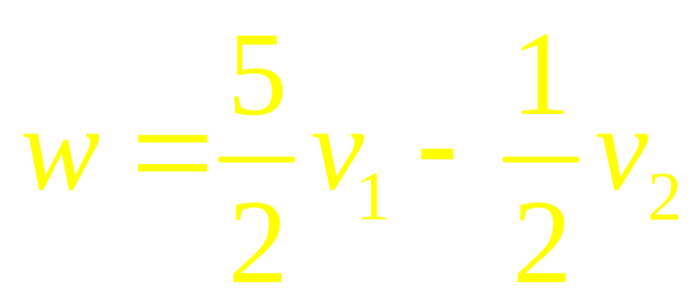
Example
.

Slide 13
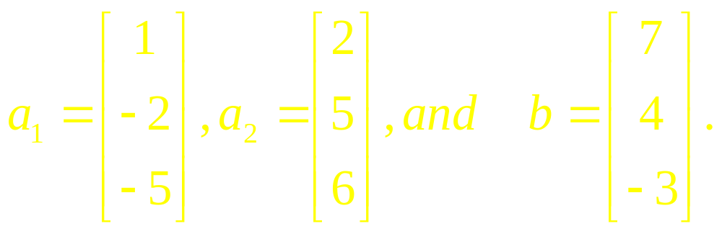

Example
.

Slide 14
Definition
If v₁, . . . , v_{p} are in R^{n}, then the set of all linear combinations of v₁, . . . , v_{p} is denoted by Span {v₁, . . . , v_{p} } and is called the subset of R^{n} spanned (or generated) by v₁, . . . , v_{p} .

Slide 15
Definition
That is, Span {v₁, . . . , v_{p} } is the collection of all vectors that can be written in the form c₁v₁ + c₂v₂ + …. + c_{p}v_{p}, with c₁, . . . , c_{p} scalars.

Slide 16
Question?
Whether a vector b is in Span {v₁, . . . , v_{p} } ?
amounts to asking whether the vector equation x₁v₁+x₂v₂+…+x_{p}v_{p}=b has a solution

Slide 17
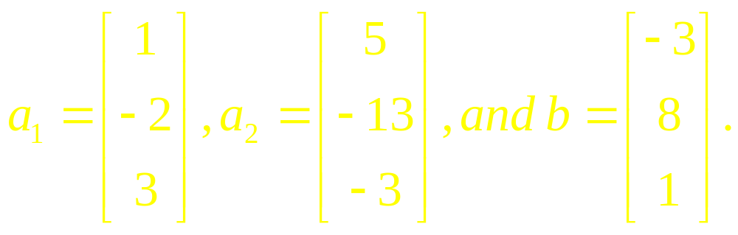
Example 6
.

Slide 18
Example 7
.

Slide 19

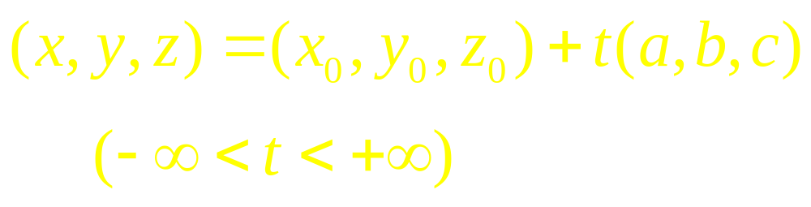
Vector and Parametric Equations of a Line

Slide 20
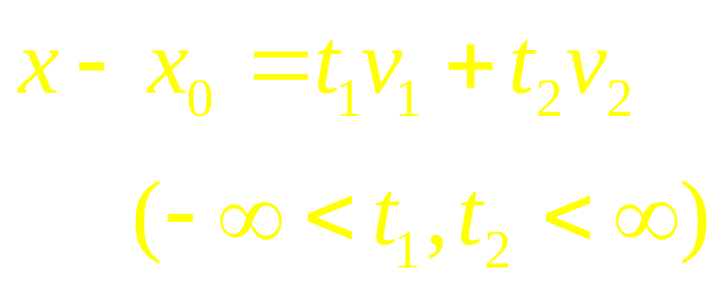
Vector and Parametric Equations of a Plane

Slide 21
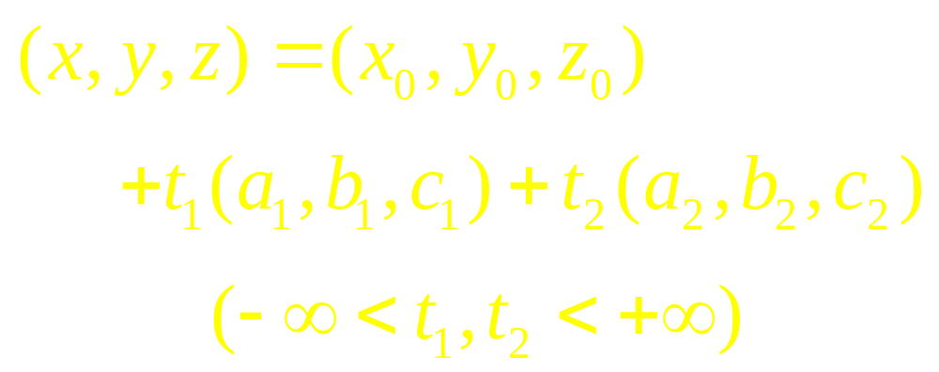
Vector and Parametric Equations of a Plane

Slide 22
Examples

Slide 23
Linear Algebra
Lecture 5

